Slide 1
Church Council Year in Review 2024 Thanks Be to God for another year of serving our Lord’s people within our congregation and throughout the community.
2 Corinthians 9:12
“This service that you perform is not only serving the needs of the Lord’s people but is overflowing in many expressions of thanks to God.”

Slide 2
Thank You for Supporting Zion’s Ministry, Missions and Outreach Projects
2024
Evangelism
LZPS
Master’s Mana
MITES
LWML
Various Congregation, District,
& Synod
Projects
Notes:
Chrysalis
Veterans

Slide 3
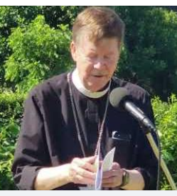
On-Line Worship Services and Information Sharing
2024
Evangelism
Thanks to the generosity of a very talented member, Zion’s worship services are recorded and shared on-line through Zion’s YouTube channel.
Information is posted & shared through Website & Facebook.
Members unable to attend church in person as well as individuals throughout the community are benefiting from this spiritual outreach

Slide 4
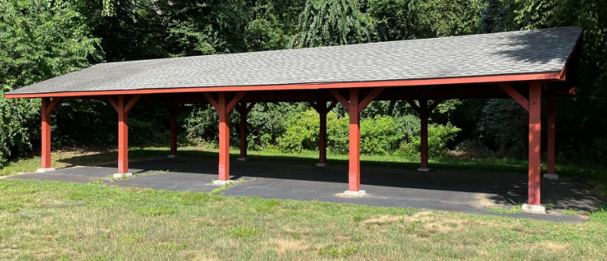
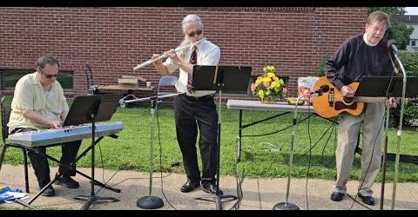
Outdoor Worship Services at Pavilion and Gazebo.
2024
Worship
Thank You Pastor and those who helped set up the outdoor services. It is a blessing to gather in the beauty of God’s creation.
To help with the logistics of setting up before and putting things
away after outdoor services contact: Pastor or Steve S.

Slide 5
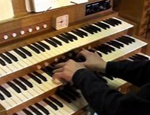
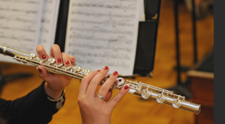
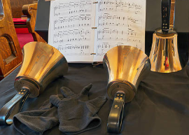
2024 Music Ministry
2024
Music Ministry
We are Grateful for Zion’s Music Ministry which provides excellent support throughout the year for worship services and special church events.
To get involved with the Music Ministry contact Cindy V.

Slide 6
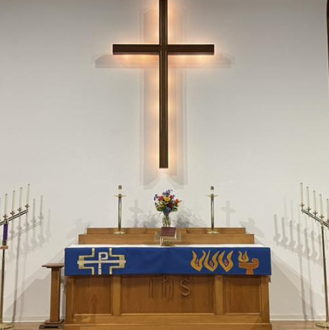
2024 Altar Guild Activities
2024
Altar
Guild
Thank You to all our Altar Guild Members who faithfully serve throughout the year.
To help support the Altar Guild contact: Shirley B.

Slide 7
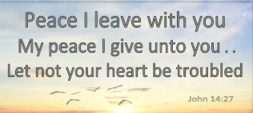
Elders Conducted Church Services while Pastor was on vacation visiting family.
2024 Elders
Church services for the 7th Sunday after Pentecost were conducted by the Elders focusing on the blessings of rest and peace through Jesus.
Thank You for your service and leadership in supporting these worship services.

Slide 8
Lenten Suppers, Devotions and
Holy Week Services
2024
Worship
Our congregation was blessed throughout the Lenten Season with
special occasions for fellowship, worship and prayerful contemplation.
Thank You to all who helped and participated. The excellent food, fellowship and generosity provided by members enriched our Lenten and Holy Week activities.

Slide 9
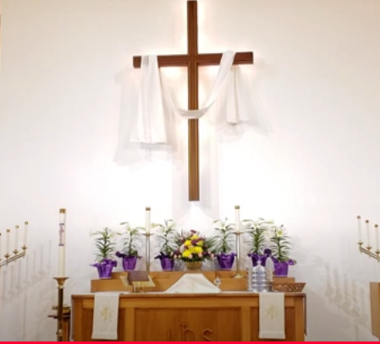
It was a blessing to celebrate Christ’s resurrection with a beautiful liturgy, talented musicians and gifted singers. Both services were well attended by a joyful congregation.
Thank You to Pastor, Elders, Altar Guild and our talented musicians.
Joyful Easter Sonrise and Easter Sunday
Worship Services
2024
Worship

Slide 10
Little Zion Preschool 36th Year Quality Education With a Christian Foundation
2024
Little
Zion
Preschool
Little Zion Preschool had an excellent 36th year in 2024. THANK YOU LZPS Director Candace, Staff and Preschool Board Members. Go to the LZPS website to view all the exciting learning opportunities, activities and events that were provided.

Slide 11
First Aid, CPR, NARCAN and AED Training
2024
Little
Zion
Preschool
Little Zion Preschool hosted First Aid, CPR, NARCAN and AED training for school staff, families and church members.
Thank You Little Zion Director Candace for providing this training.

Slide 12
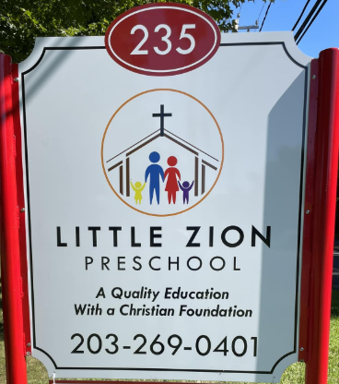
Little Zion Preschool New Sign Quality Education With a Christian Foundation
2024
Little Zion Preschool
A new sign for Little Zion Preschool was designed and installed by very generous members.
Thank You

Slide 13
Little Zion Thanksgiving Presentation
2024
Little Zion Preschool
This event and others conducted by the LZPS staff was well organized and well supported by students and their families.
Thank You Candace and staff!
Go to Little Zion website and Facebook page to see all the excellent activities throughout 2024.

Slide 14
Support for Master’s Mana
2024
Evangelism
It was a blessing that Zion WINGS and members continued donating and transporting food to help those in need throughout 2024.
Monthly food collections for Master’s Mana are continuing.

Slide 15
Hosted Community Blood Drive
2024
Community
Outreach
Thank You Dianne M. for coordinating this event.

Slide 16
Direct Mail Postcard Invitations
2024
Evangelism
The Elders Sent out Postcard Invitations to the local community highlighting services and opportunities for families and individuals at Zion.
Thank You for sharing the Gospel Message.

Slide 17
2024
Evangelism
OUTREACH & MISSIONS PIZZA PARTY
On March 2nd, we celebrated Zion’s Missions & Outreach activities, shared our favorite pizza and launched 3 new Evangelism Initiatives!
1. Selected Jensen Missionaries 2024 Mission Central Project
2. Established Mission & Church Brochure Team
3. Planned Evangelism Training
Thank You to all who shared their favorite pizza and desserts. We appreciate all the participants who supported 2024 outreach &
mission activities throughout the year.

Slide 18
Meet & Greet Hospitality Evangelism Training
2024
Evangelism
Thank You Pastor for an informative session that included:
How to share things we like best about our church.
How to invite and welcome visitors.
The LASSIE method of communication.
LASSIE Approach to Evangelism
Listen
Ask
Seek
Share
Invite
Encourage

Slide 19
Authentic Concise Mission Statement
2024
Evangelism
Thank You to the team of Zion Members who used words from the 1891 Church Constitution and 1999 Mission Statement Project to write a mission statement that will help unite and inspire our congregation.
Our mission is to:
love, support and strengthen each other
as God’s ambassadors,
sharing the Gospel message of salvation in Jesus Christ.

Slide 20
New Church Brochure
2024
Evangelism
A team of 12 Zion talented members developed a new Church Brochure to help inform and invite people.
Thank You
to everyone who
helped design
and distribute
the new brochures
Please share a church brochure with family, friends and acquaintances.

Slide 21
Church Banners
2024
Evangelism
A team of Zion members developed 3 banners to complement the new Church Brochure as communication tools helping inform and invite people to begin a faith journey with us at Zion.
3 Banner Themes:
Mission Statement
Word & Sacrament
Invitation
Thank You
for sharing your
talents & skills

Slide 22
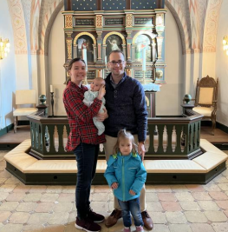
2024 Mission Central Project
2024
Evangelism
A sincere Thank You was received from Rev. Nathaniel Jensen
and family for Zion’s donation of $1,610.00.
Pastor Jensen is revitalizing a church in Germany that US military personnel attend. He also serves Lutheran Partner Churches in the region and teaches at the local seminary.
Emma helps with the music ministry for their congregations.
Their young daughter Agatha and infant Cecilia are with them in the mission field.
Thank You for a Huge Success

Slide 23
Hosted the 2024 Coalition For a Better Wallingford Community Picnic
2024
Evangelism
~1,000 participants attended, became more aware of our congregation and experienced Zion Hospitality. Thank You to all who supported the event.

Slide 24
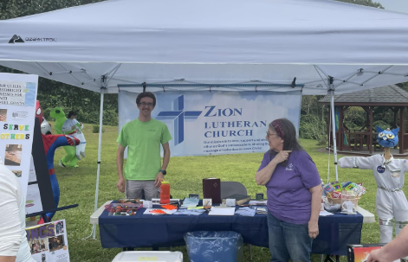
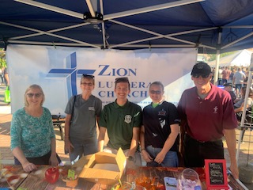
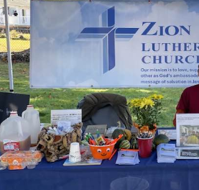
Meet & Greet Hospitality Evangelism at Public Events
2024
Evangelism
In concert with Little Zion Preschool, 12 Zion members shared information about our church and school at 3 public events. 350 new church brochures were distributed. Thank You for serving as God’s Ambassadors.

Slide 25
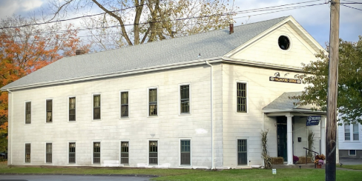
Community Outreach
Prayers at Grange and Night of Remembrance
2024
Evangelism
Thank You Pastor for the opening prayers at the Wallingford Grange and CFABW Night of Remembrance events. Starting these events with prayer helps bring the community together and reminds us of the peace and blessings of the Gospel.

Slide 26
Coffee & Hospitality Fellowship
2024
Fellowship
Thank You to all who supported Coffee and Hospitality activities throughout 2024.

Slide 27
2024 Chili Cookoff
2024
Fellowship
Pastor won 1st Place for his traditional chili recipe. $389.00 was donated to CFABW. It was a lot of fun. Many Thanks to all who supported and participated!
Thank You Tim F. JR. for coordinating the event! We are looking forward to the January 25, 2025 Chili Cook-off.

Slide 28
2024 Zion Men’s Club
2024
Fellowship
Men of Zion Monthly Breakfast Meetings
Supported landscaping projects
Conducted Chili Cookoff
Supported special events, projects and activities
Contact: Steve S.
Thank You to all who participated.
All Men of Zion are welcome to participate in 8:30 AM meetings on the
3rd Saturday of each month

Slide 29
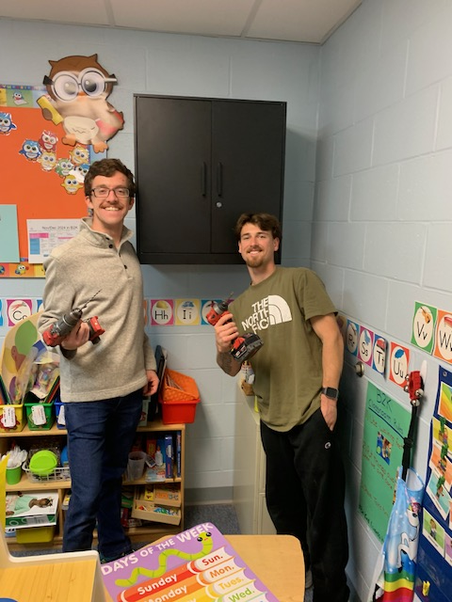
Assembled and Installed Cabinets For Little Zion Preschool
2024
Men’s Club
After a Men of Zion meeting,
Stephen F. and Brian W. stuck
around to assemble and
install 2 metal cabinets.

Slide 30
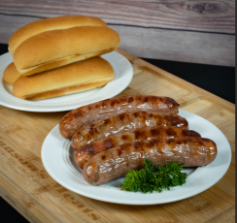
2024 Brats & Dog Roast
2024
Trustees
Fellowship
Zion’s Trustees conducted a Brats and Hotdog Roast fellowship event. Thank You to all who supported and participated in the tasty event.

Slide 31
Zion T Shirts
2024
Fellowship
Zion T Shirts were designed and made available to increase Zion teamwork and identity.
Contact Amy M. or the church
office to get a shirt.
Thank You Amy for your talent and energy in making these nice shirts available.

Slide 32
LWML NED SPRING GATHERING
2024
WINGS
A very successful LWML event was hosted by our Zion WINGS
Thank You everyone who supported and participated in the event.

Slide 33
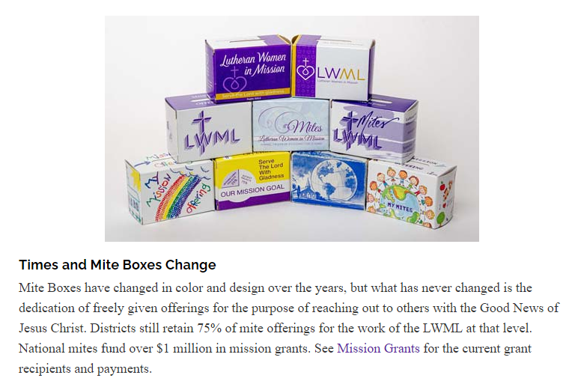
Continued Monthly Mites Collections
2024
WINGS

Slide 34
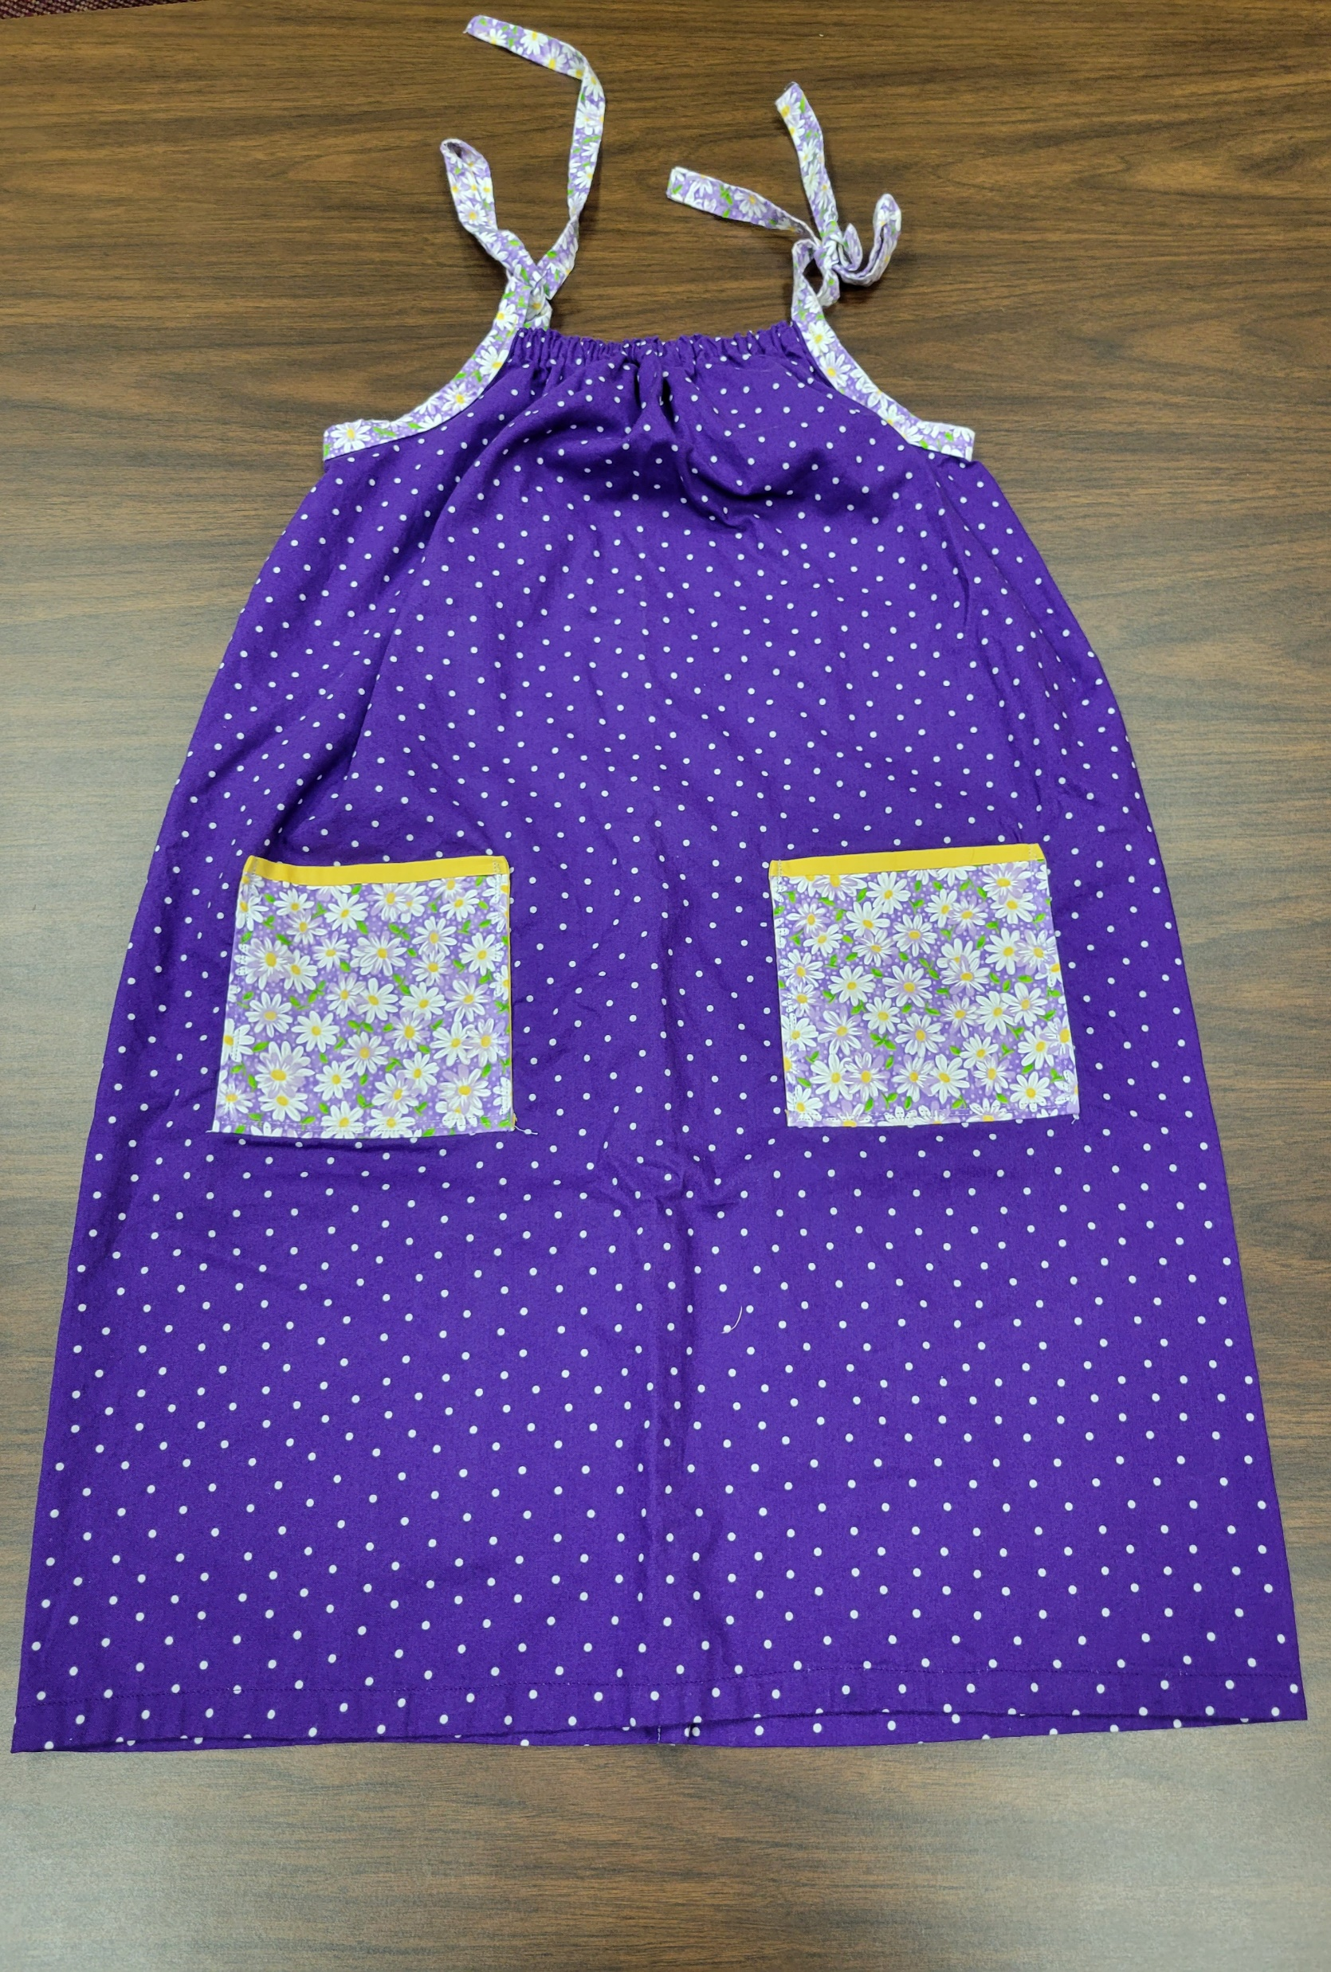
2024 Quilting Ministry
2024
Quilting
Ministry
Continued making and donating quilts.
Continued making clothing and needed items.
Dozens of hand-crafted fabric items were lovingly made and delivered to those in need.
Continued donations of bibles and devotionals.

Slide 35
2024 Spring Cleanup
2024
Trustees
Our trusty Trustees organized and supported the cleaning of exterior and interior church areas.
Thank You Gordon C. and team.

Slide 36
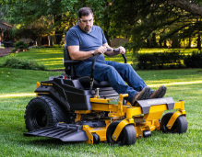
Maintenance of Church Infrastructure
2024
Trustees
Zion’s Trustees continued to support the ongoing maintenance and repair of church interior and exterior infrastructure and equipment.
To help support maintenance activities contact: Gordon C.

Slide 37
2024 LED Project
2024
Trustees
New LED lights providing greater illumination and using less electricity than the old lights have been installed in hall and office. More areas to receive LEDs.
The visionary efforts of the Trustees in supporting this project is a shining example of teamwork
and generosity at Zion.
Continued interior LED lighting upgrades
Including Pastor’s office

Slide 38
Roofing Project Completion
2024
Trustees
Completed the final flat section of the roof project

Slide 39
2024 Plumbing & Heating Projects
2024
Trustees
Replaced water faucets – Thank You Joe B.
Major repairs to furnace and hot water systems
Replaced sewer pump

Slide 40
Established Snow & Ice Removal Contract
2024
Trustees
Generated Request For Quotation
Analyzed Contractor Proposals
Negotiated Agreement with capable contractor
Includes all church & parsonage vehicle and pedestrian areas.
Contact: Gordon C.
A typical light winter storm will cost around $350.00 for snow plowing and $175.00 for ice control. Heavy snowfalls will be more expensive. A special Snow Removal Fund has been established for those who wish to help cover the costs.

Slide 41
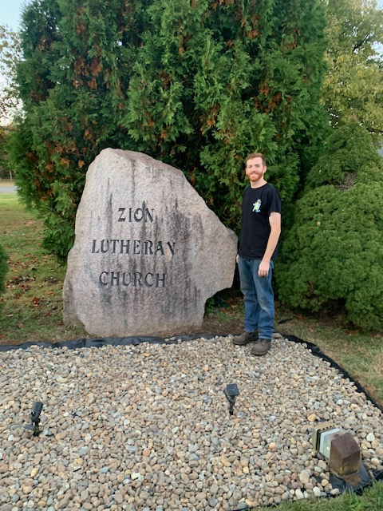
Landscaping Project at the Zion Rock
2024
Trustees
Thank You Tim F. Jr.
Removed weeds
Installed landscape fabric
Installed stone

Slide 42
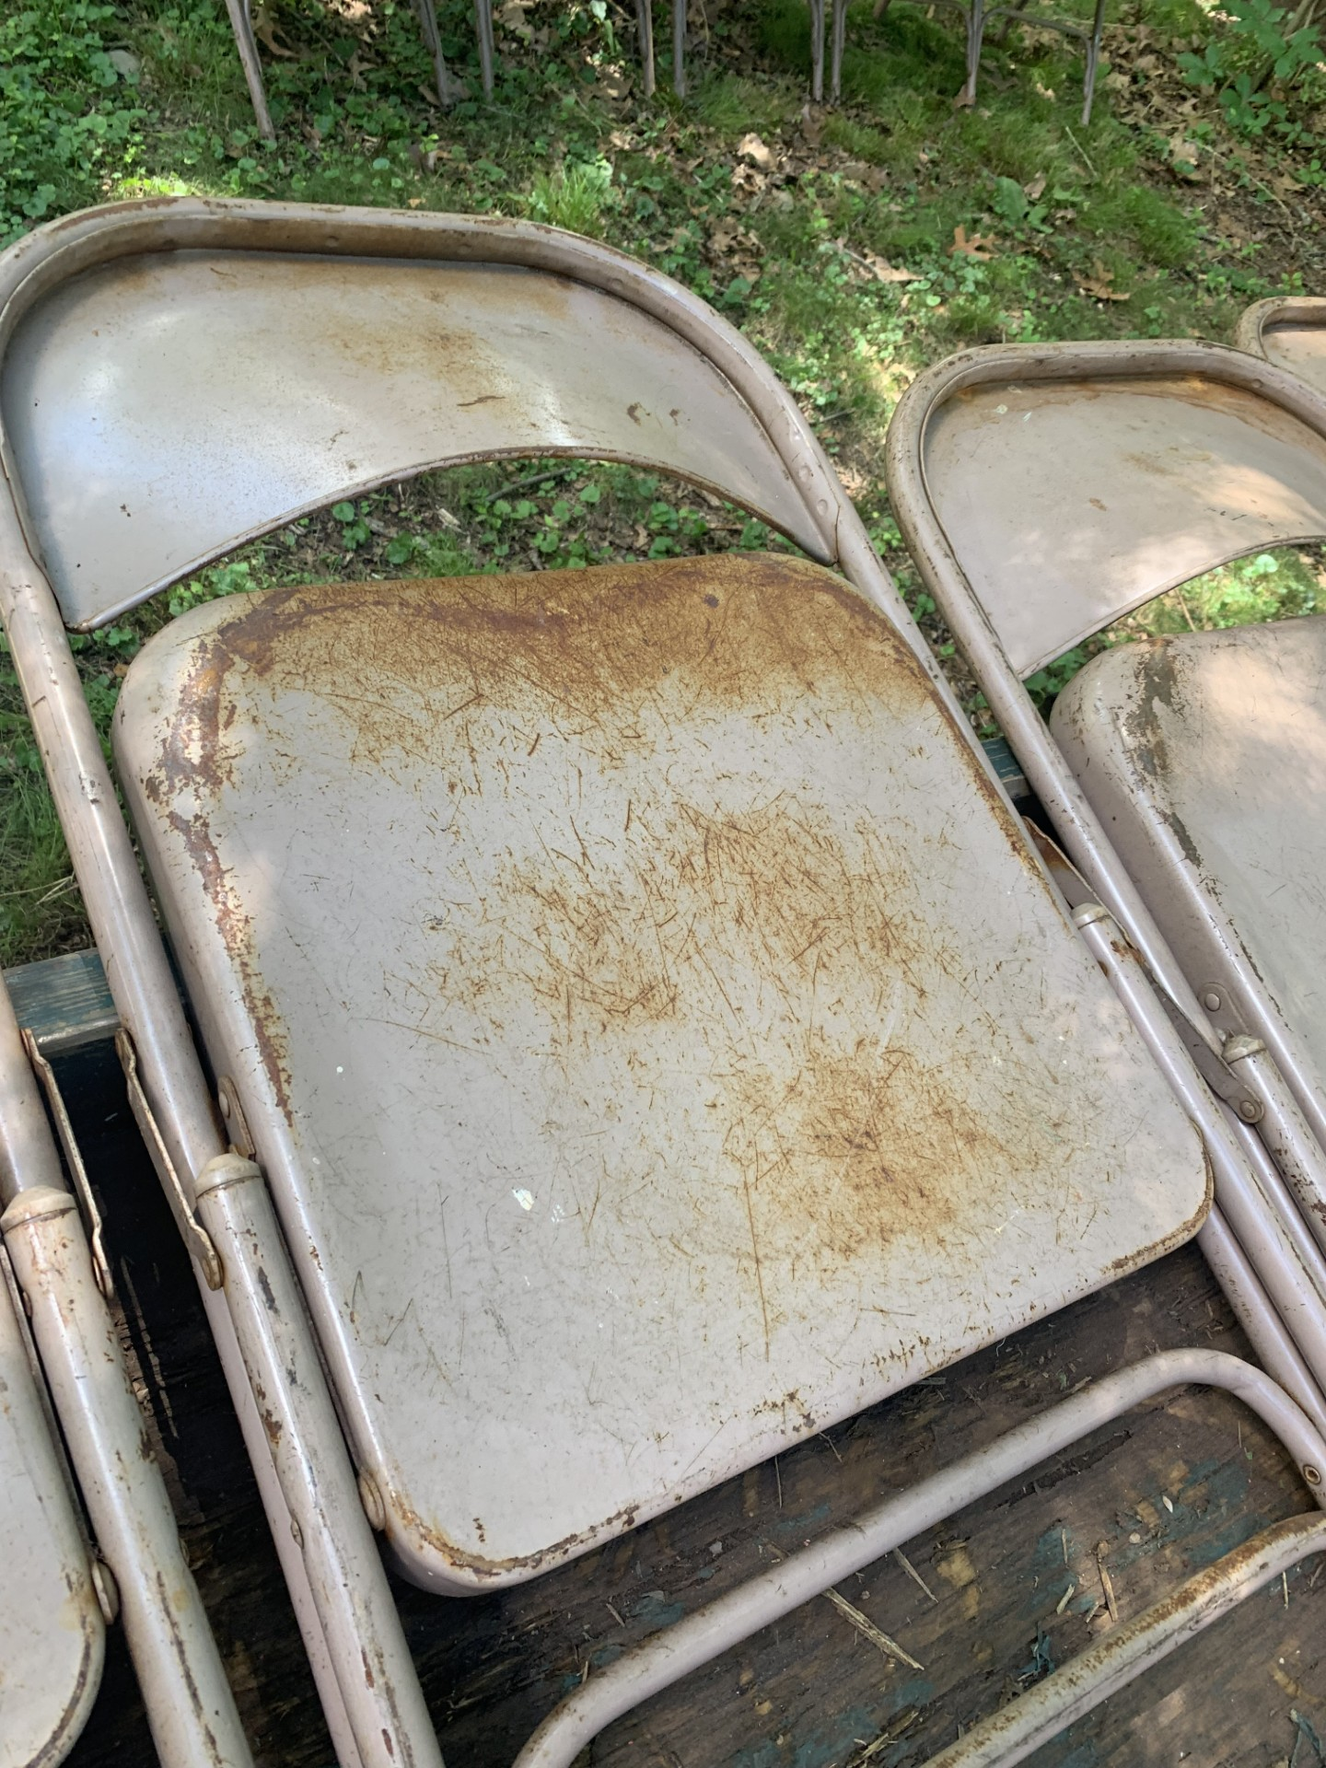
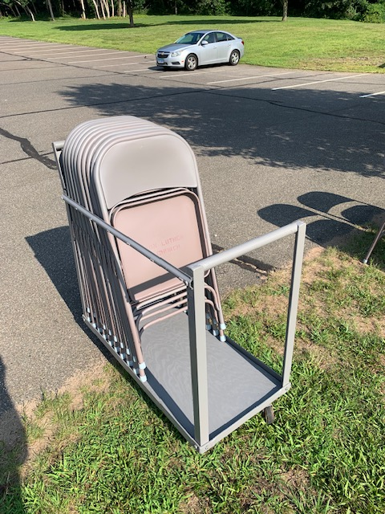
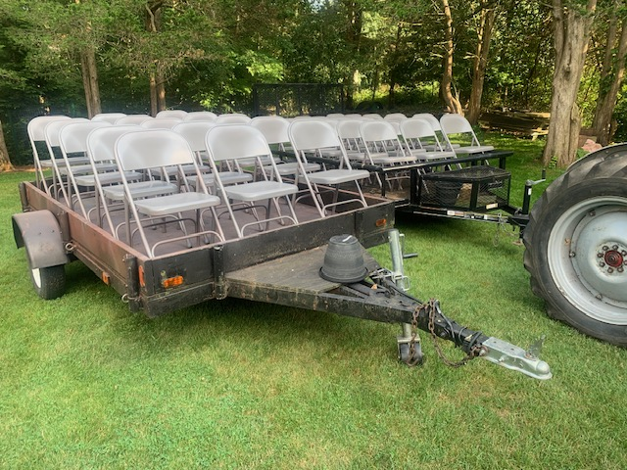
Painted Metal Chairs
2024
Trustees
Sanded, primed, and painted 60 tan and 30 gray folding chairs. Fabricated small chair cart.

Slide 43
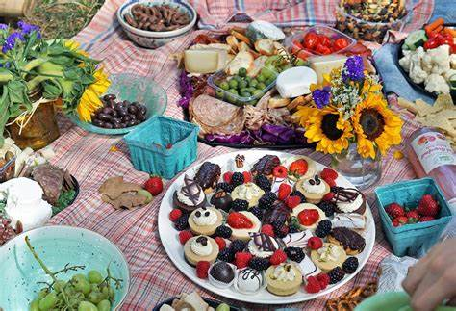
2024 Rally Day Picnic
2024
Sunday
School
Conducted 2024 Church Picnic and Rally Day with family focused outdoor worship service followed by delicious food and games at the pavilion.
Thank You

Slide 44
2024 Easter Egg Hunt
2024
Sunday
School
Conducted Easter Egg Hunt.
Thank You

Slide 45
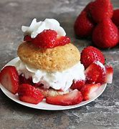
2024 Strawberry Shortcake event.
2024
Youth
Group

Slide 46
2024 Valentine Dinner
2024
Youth
Group
The Valentine Dinner was well attended and a huge success. Many Thanks to all who supported and attended the event!

Slide 47
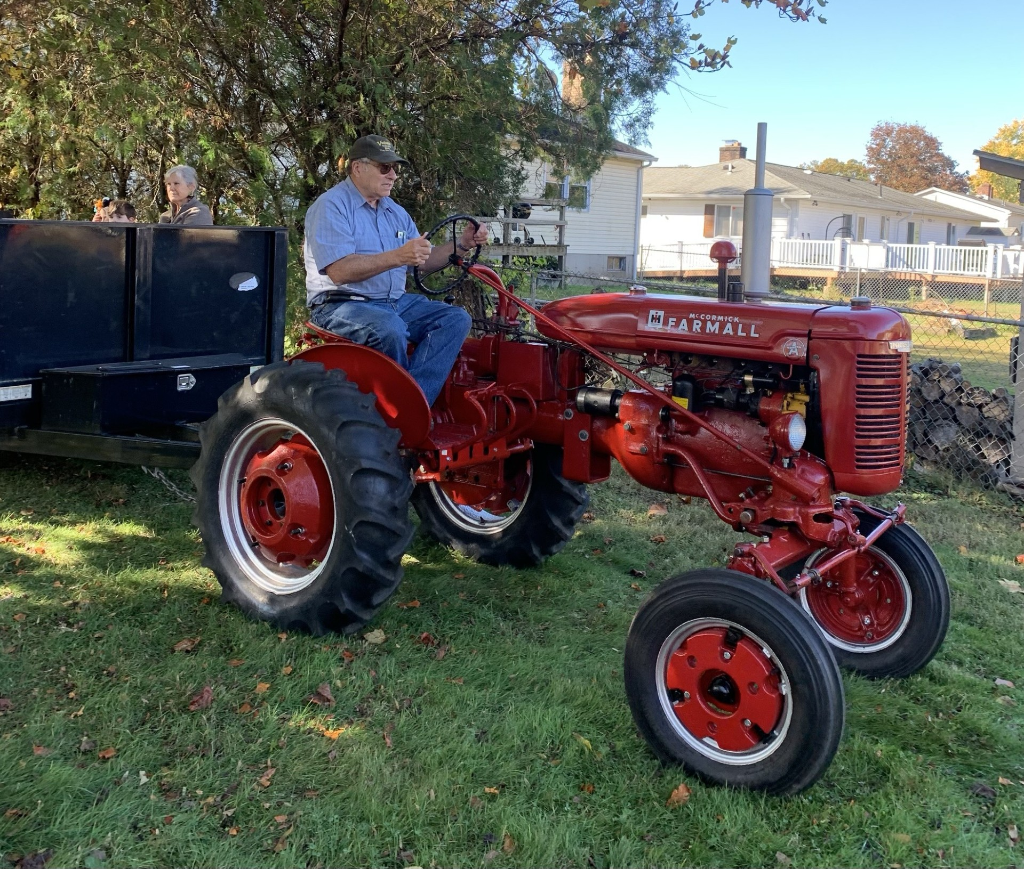
2024 Scarecrow Festival
2024
Scarecrow
Festival
Community
Outreach
2024 Beneficiary:
Kinder Ground Café
$5K donation
Contact: Joe B.
Thank You Joe B. and everyone who supported this Huge Success

Slide 48
2024 Congregation Brunch & Voter’s Meeting
Conducted Congregation & Voter’s Meeting instead of typical April Voter’s Meeting to provide information and encourage greater participation.
2X the number of members attended compared to typical Voter’s Meeting and enjoyed fellowship while sharing church information.
Contact: Steve S.

Slide 49
2024 Stewardship Presentation
Conducted holistic Stewardship Presentation highlighting biblical teachings about sharing spiritual blessings and gifts of time, talents and treasures.
Encourage true stewardship and debunk the idea that stewardship is only about asking for money.

Slide 50
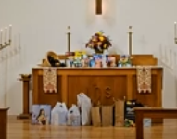
2024 Thanksgiving Eve Service
2024
Worship
Gratitude and Generosity abounded at our Thanksgiving Eve Service as we gathered to give thanks for all our blessings and to share our gifts with Master’s Manna.

Slide 51
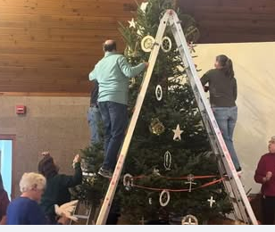
2024 Christmas Tree Trimming
2024
Fellowship
Thank You to those who donated the tree once again and organized another festive tree trimming party!

Slide 52
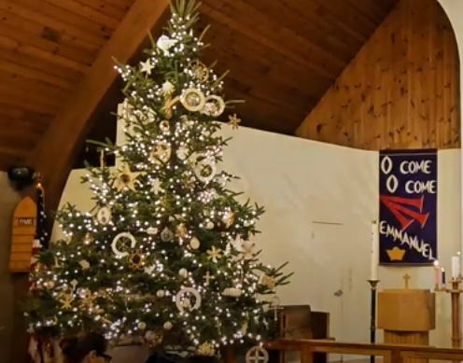
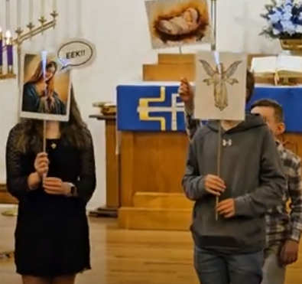
Children’s Christmas Service
2024
Sunday School
Little Zion
Thank You to everyone who organized and participated in Children’s Christmas Activities at Zion.

Slide 53
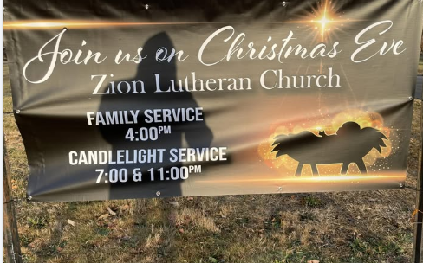
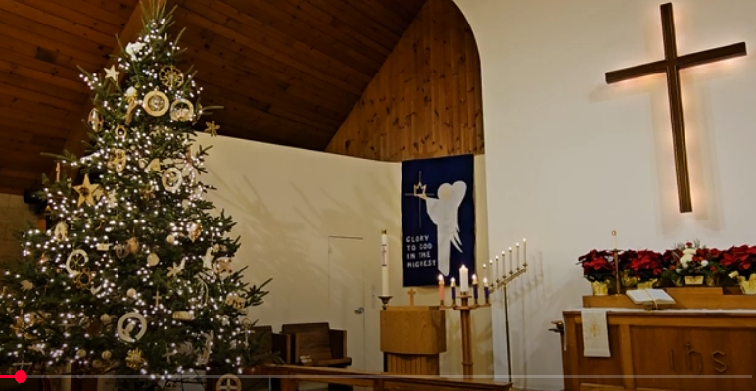
Christmas Services
2024 Worship
Thank You Pastor, Altar Guild and Music Ministry for 3 Christmas Eve and a Christmas Day service. These joyful worship services are a blessing to all who attend.
The new Christmas Service Banner that was generously provided is much appreciated.

Slide 54
Communication of 2024 Goals & Accomplishments
2024
Strategic
Planning
Coordinated over 50 Goals and Accomplishments for the Church Council and helped communicate the various projects to the congregation boosting participation.
Contact Stephen F. to post Goals & Accomplishments

Slide 55
2024 a Year of Increased Communication, Evangelism & Outreach
Expanded the Communication, Outreach & Missions of Zion Lutheran Church through the following additional projects and new outcomes for 2024:
Evangelism & Missions Pizza Party
Meet & Greet Evangelism Training
Church Mission Statement, Brochure and Banners
Jensen Family Missionaries 2024 LCMS Mission Central Project:
Chili Cookoff outreach benefited CFABW
CFABW Night of Remembrance opening prayer
CFABW Community Picnic
Community Blood Drive
New Batch of Direct Mail Invitation Postcards
New Zion T Shirts encourage Zion teamwork, name recognition and public awareness
A Kinder Ground Café was the recipient of 2024 Scarecrow Festival
Zion Ambassadors distributed ~350 Church Brochures at public events
Thank You
to all who shared their time, talents and treasures
supporting many activities that helped spread the Gospel in various ways throughout 2024.

Slide 56
Give
Time, Talents & Treasures
achieve goals
Accomplishments bring learning and the development of more gifts to share.
3G’s
Awareness of our blessings & gifts brings joy, gratitude and prayers of thanksgiving.
Gratitude
Knowledge
Understanding
Appreciation
Actions
Jesus
Greatest Gift
Thanksgiving
Giving
Sharing
Helping
Fulfilment
Generosity
Self
Others
Community
Giving and sharing through generous actions brings happiness, accomplishment. and fulfilment
Goals
Gratitude inspires us to have generous goals and plans to discover and use more gifts.
https://www.lhm.org/gifted/ Lutheran Hour Ministries

